Slide 1
Comparing Parallel Boxplot

Slide 2
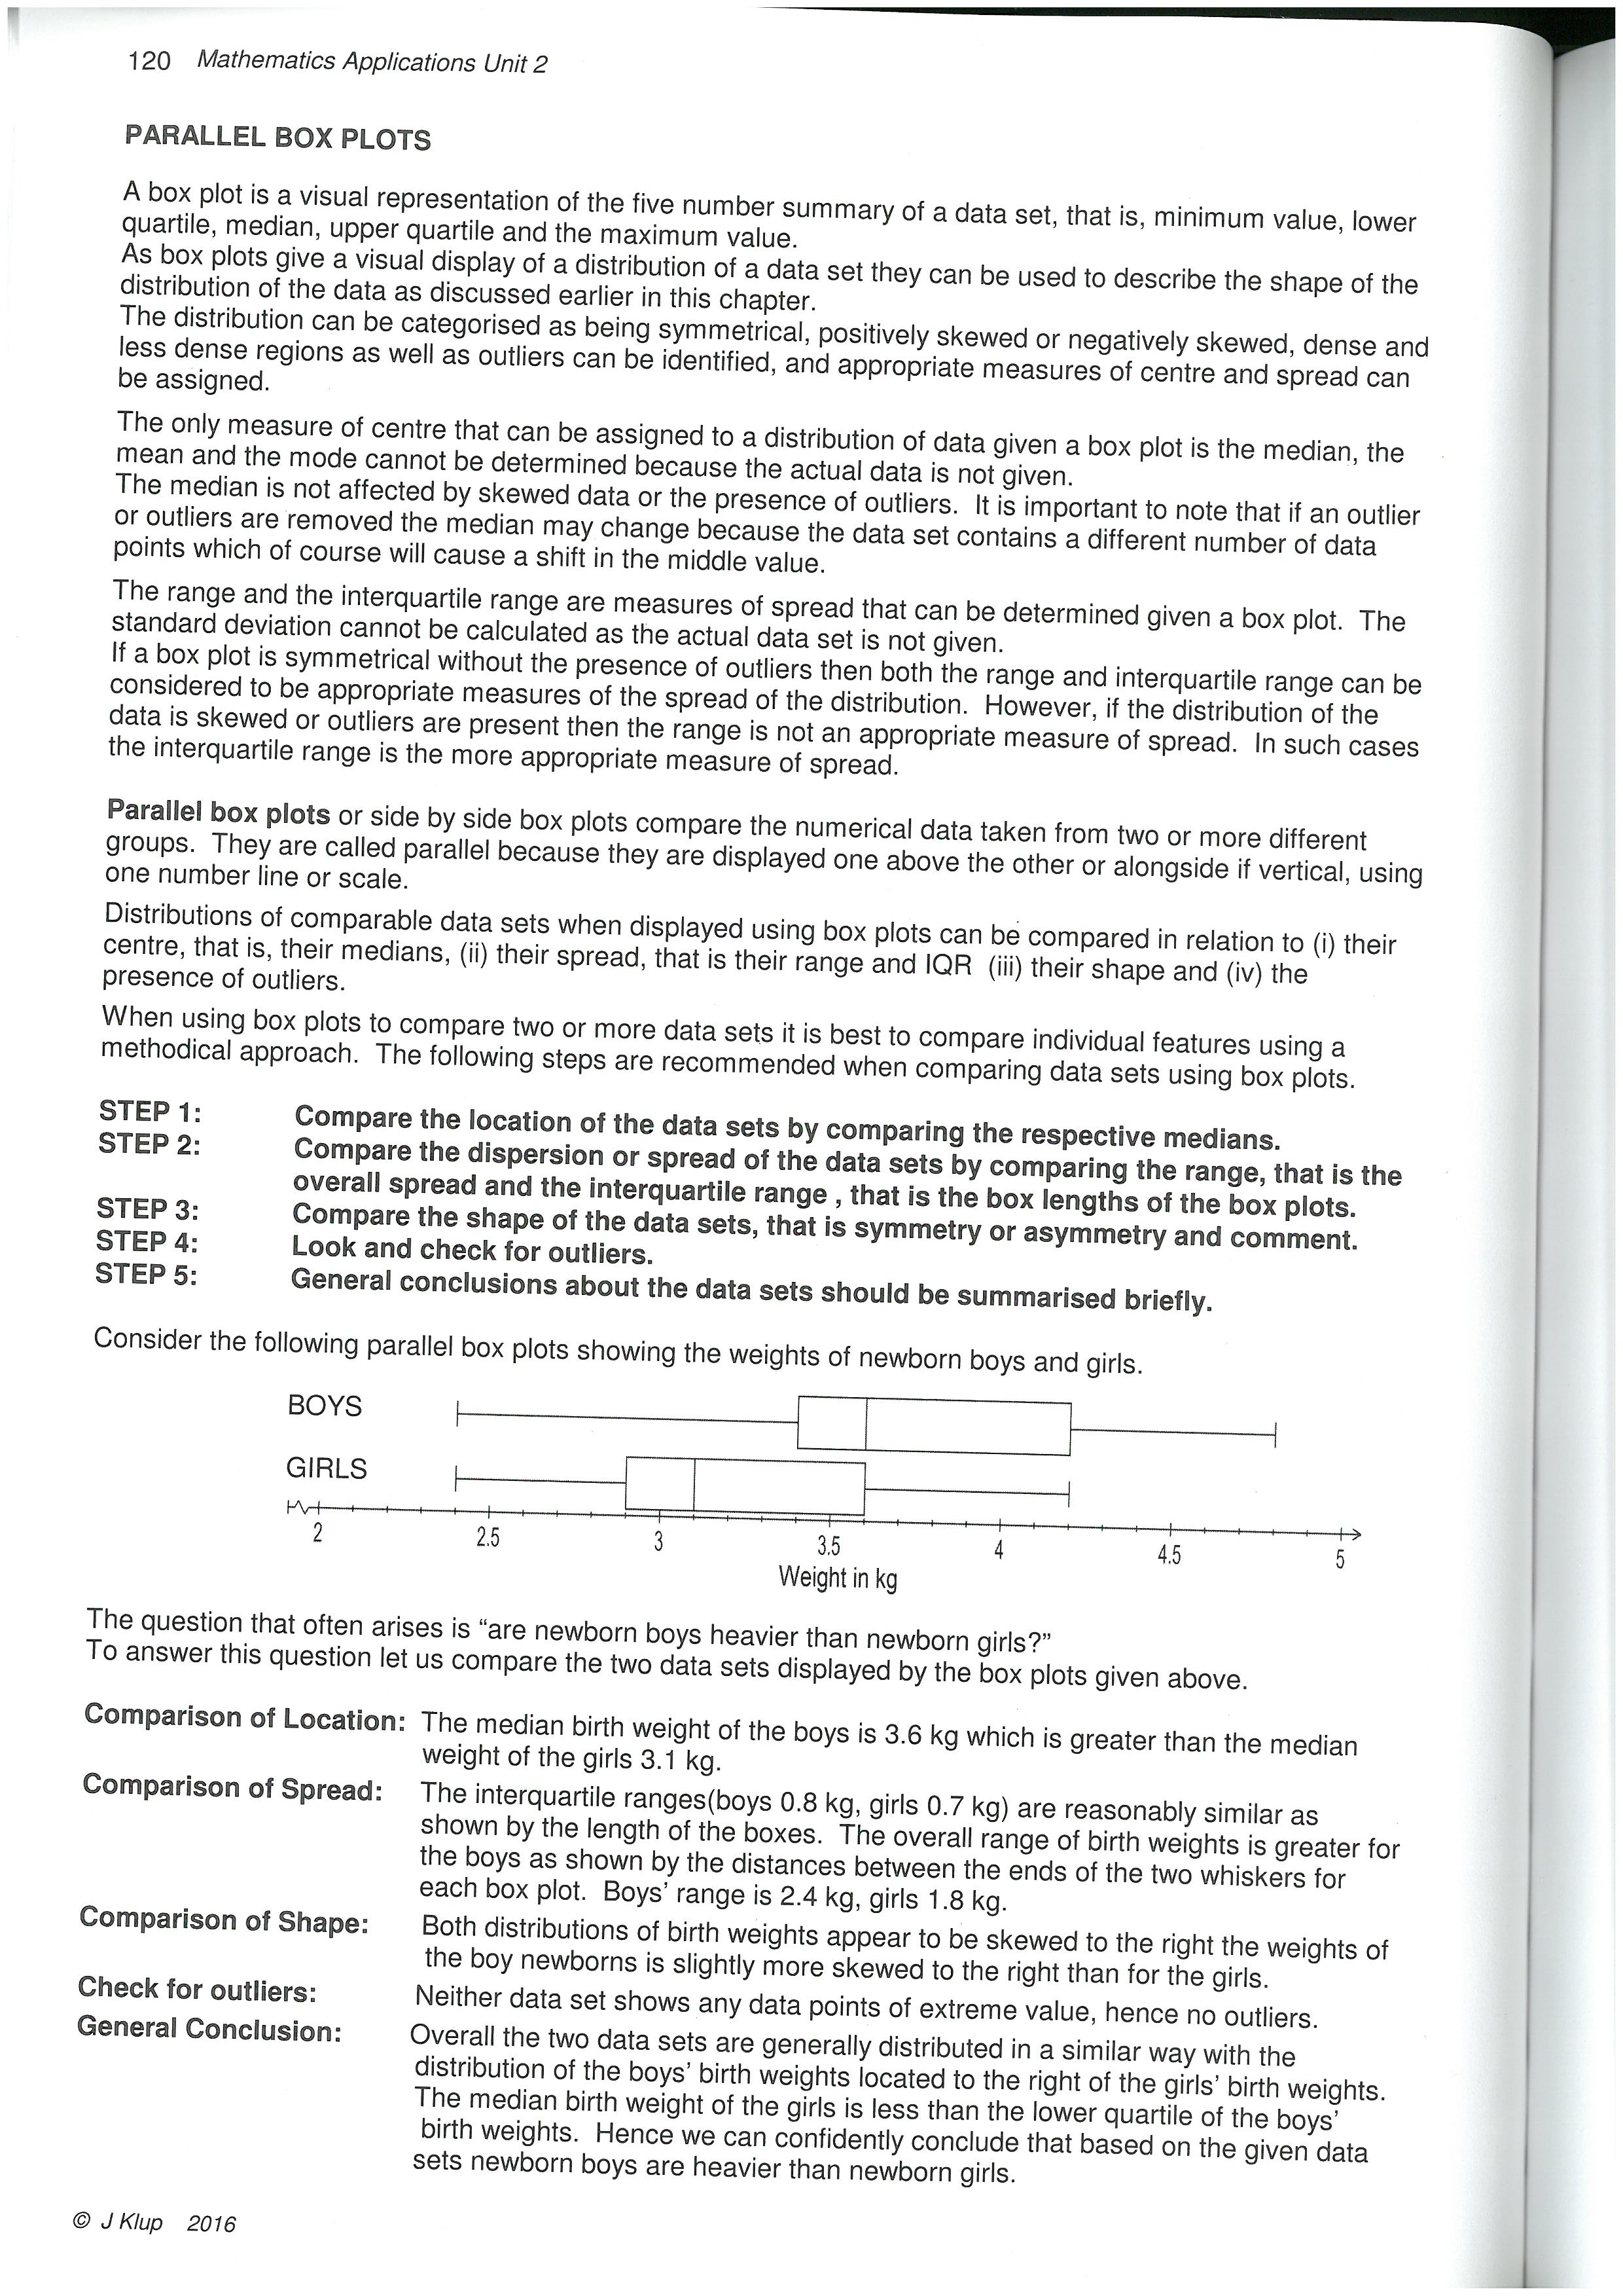

Slide 4


Slide 5
